Slide 1

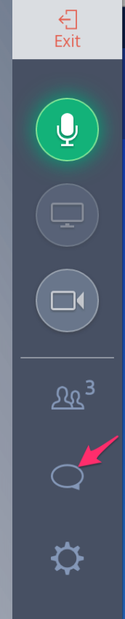
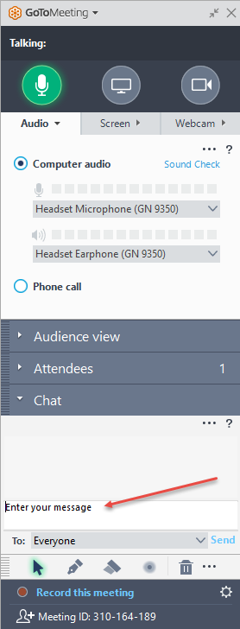
JobTracker Forms Part 2: Formatting & Phases
We’ll get started at the top of the hour.
I’ll turn on audio at least 5 minutes early… but feel free to practice posting questions in the chat area as shown in this image!
GoToMeeting Toolbars

Slide 2
Working with Forms & Phases
Business Goals
Pull info from Forms for display/print to save time & reduce errors
Manage large jobs more efficiently with Phases
Report on Jobs by Phase
Software Goals
Customize and format forms for communicating clearly on screen and in print
Import a Job Form
Separate a Job into Phases
Ensure that Job Forms are assigned to correct Phases

Slide 3
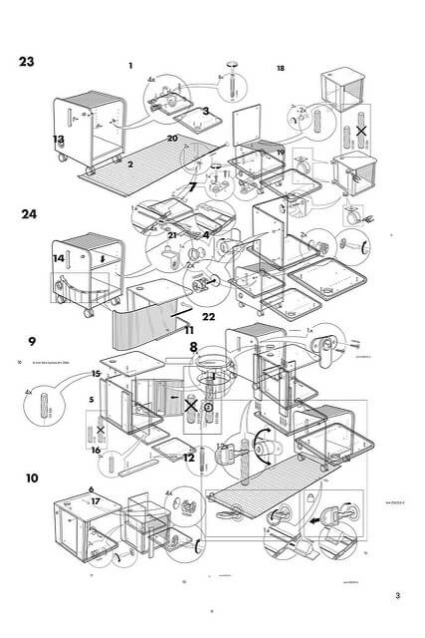
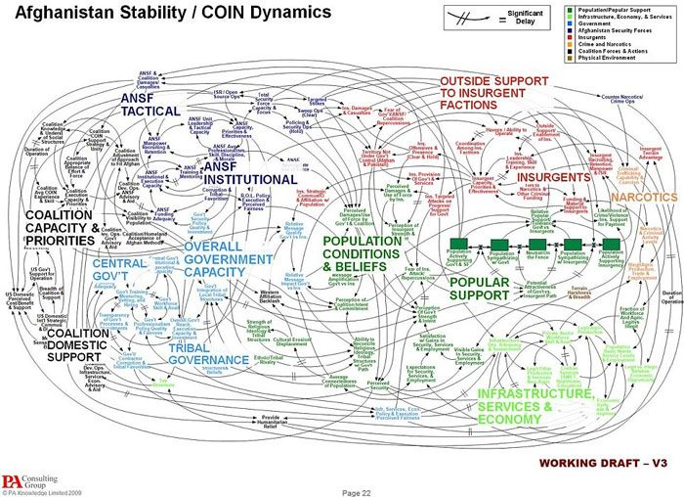
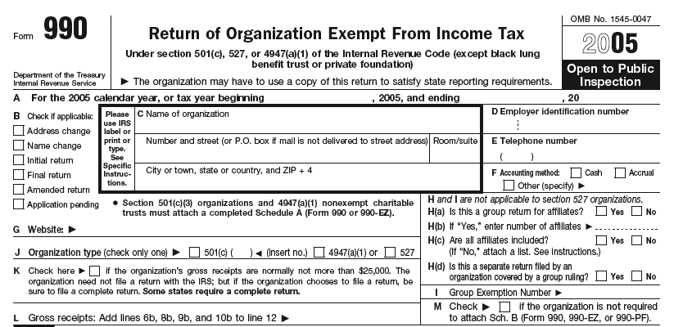

Communicating in Print
Notes:
We’ve all experienced bad visual aids, printed directions, notes, forms. The flowchart has so much detail it becomes meaningless; the IKEA instructions… anyone experience that nightmare? The notes are like my son’s idea of what it means to “show your work” in math class. And I believe the IRS 990 was designed to be difficult to read. Easier to hide the truth.

Slide 4
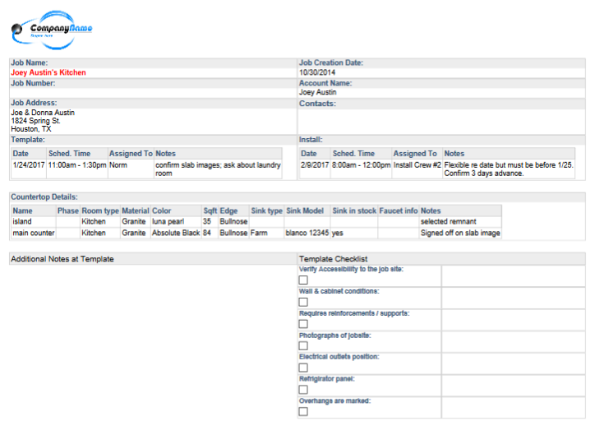
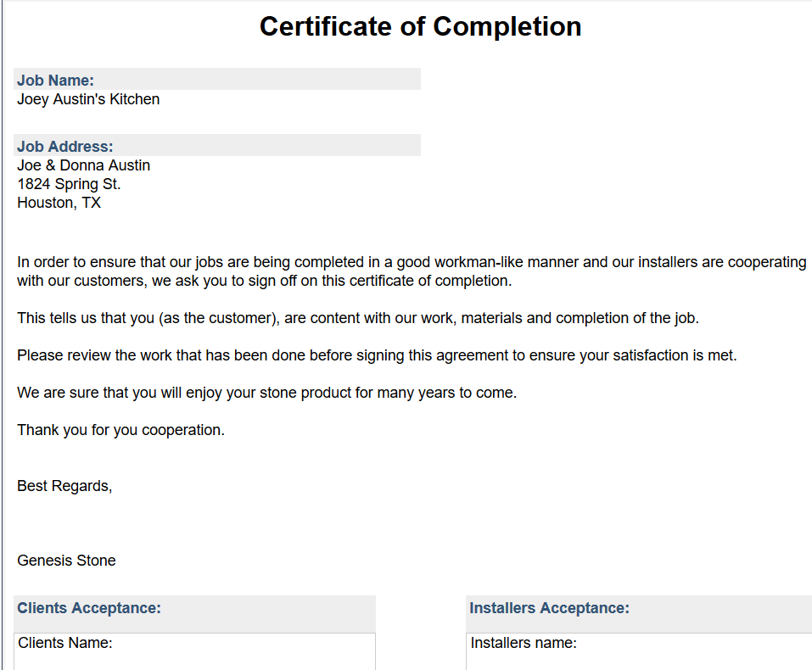
Communicating in Print
Notes:
It is worth the effort to ensure that your forms are easy to read and follow – both in print and on screen. Here are just a couple examples.
White space – in between blocks of print and for taking notes with pen/pencil.
Shading and color to call attention, organize, assist the human eye.
Summarize info

Slide 5
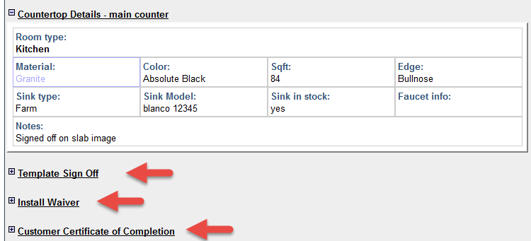
Might collapse by default
+ -
or
Expand or collapse with
Notes:
If you are attaching forms to your Jobs that are only for printing (they have no fillable, data entry fields) it’s a good idea to set them to be collapsed by default so they don’t take up as much room on screen. It’s easy to click the + sign to “show more” of a form if you want to check out what it contains. Click minus to show less.

Slide 6
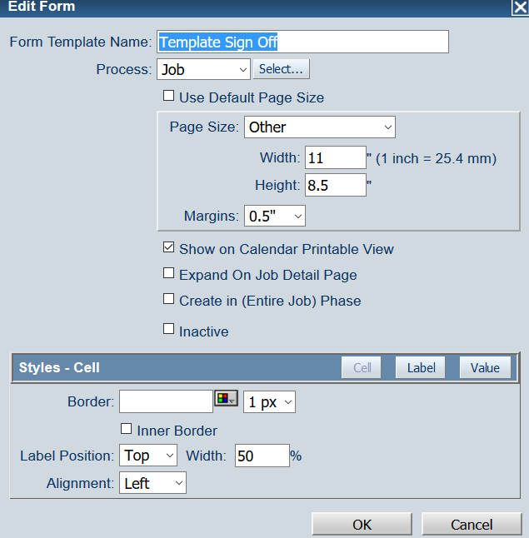
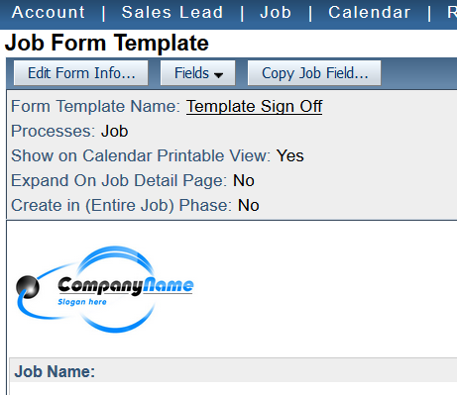
Set forms to be collapsed by default
Notes:
Notice that this form template says NO for expand on job details. If you click the Edit Form Info button you can check or uncheck that option.
You’ll also see that this is where you set the page to print in Landscape. Maybe you’ve never noticed that option before… it can be a little tricky

Slide 7
Set to print landscape
Notes:
It might be difficult to see here, but this Form is set up to print landscape – even if it is included in an Activity Packet with other forms that print Portrait.

Slide 8
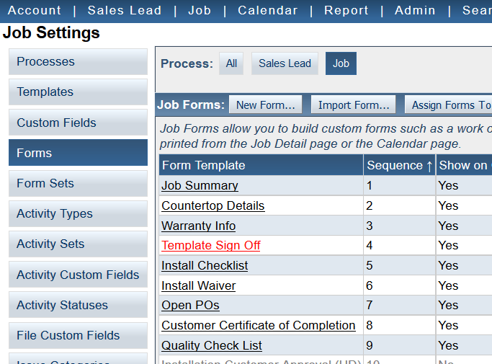
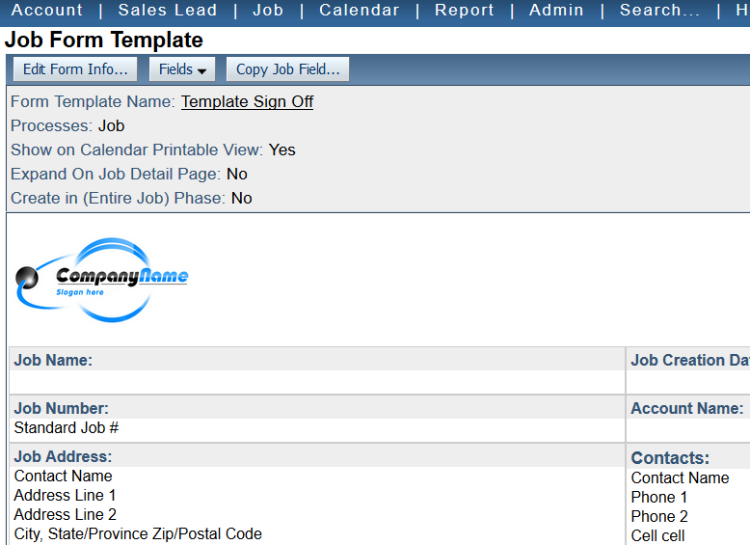
Job>Edit Settings and then Edit Form Info
Notes:
Go back to Job>Edit Settings and open the Form Template to edit. Click the Edit Form Info button.

Slide 9
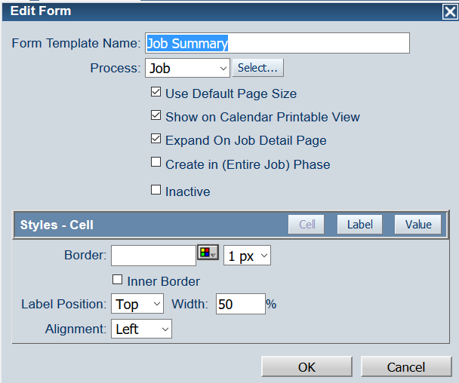
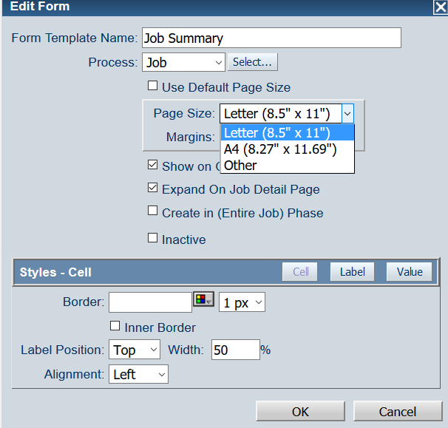
Set to print landscape
Notes:
In the Edit Form dialog box, uncheck “Use Default Page Size”. Then chose “Other”

Slide 10
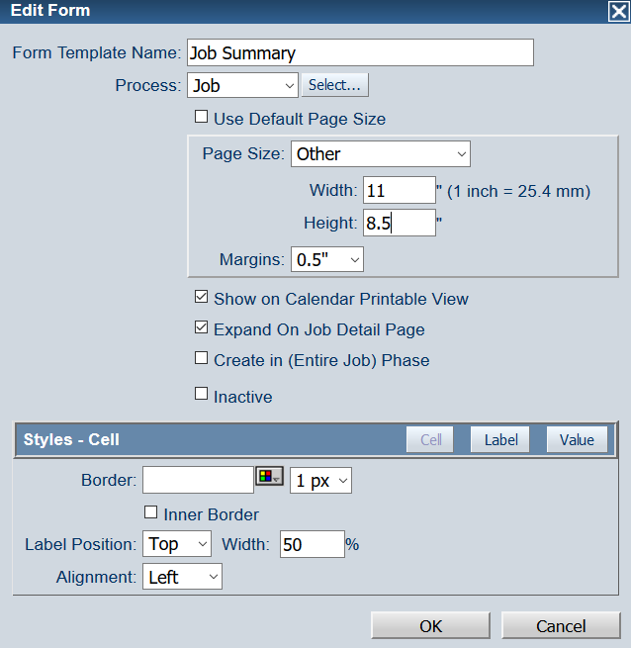
Swap width and height
Set default formatting
Notes:
Enter 11 by 8.5 (instead of 8.5 by 11).
[TRANSITION HERE… “Set default formatting” will fade in on next click.] If you designing a form and you don’t want any of the “blocks” to have borders or you want all of the text to be a specific font, you can set the default formatting for the entire form here. How do these formatting tools work? Let’s take a look now.

Slide 11
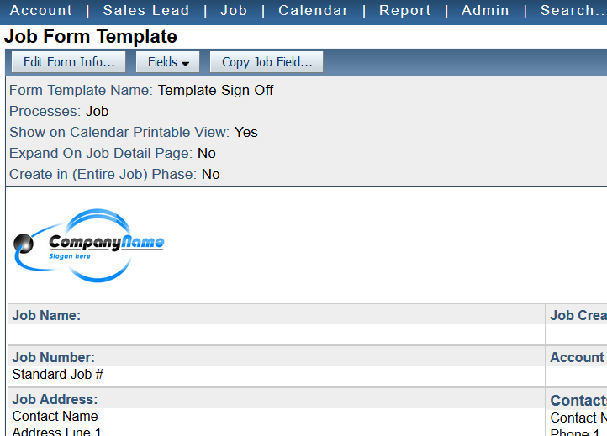
Format individual fields

Slide 12
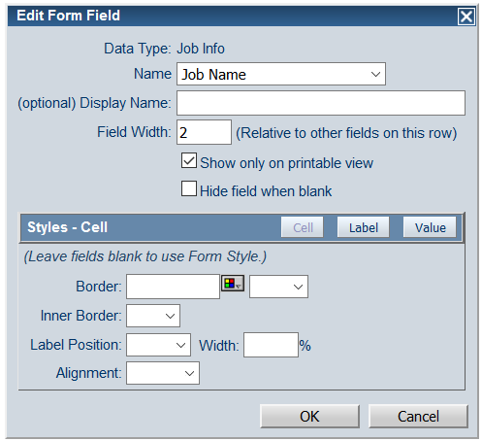
Edit Form Fields
Job Name is 2x as Wide
Notes:
The Field Width option is where to tell JT how big this field should be IN RELATION to the other fields on the same line. Takes experimentation. It’s a good idea to first get things on the lines that you want, and then play with field width.

Slide 13

Edit Form Fields
Cell = the box itself
c
Notes:
Change the border – make it 0pt or just lighter

Slide 14
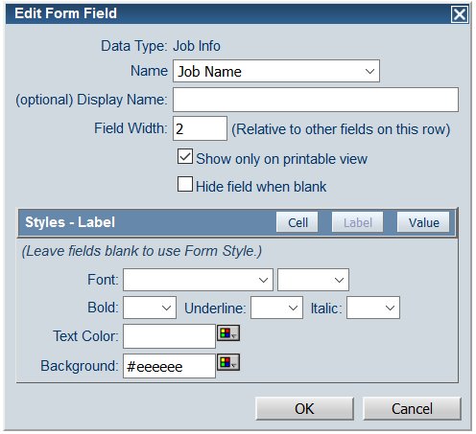
Edit Form Fields
Label = label area
c
Notes:
Apply background or remove.
Change Display name and format the fonts

Slide 15
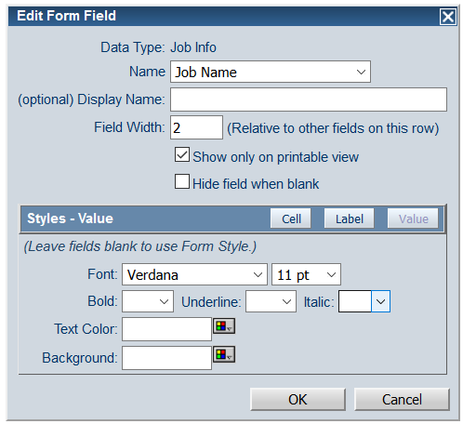
Edit Form Fields
Value = Contents of cell
c
Notes:
Change the font name, color and size for the data that will end up IN the box.
Notice – you can’t chose alignment here. That’s Cell

Slide 16
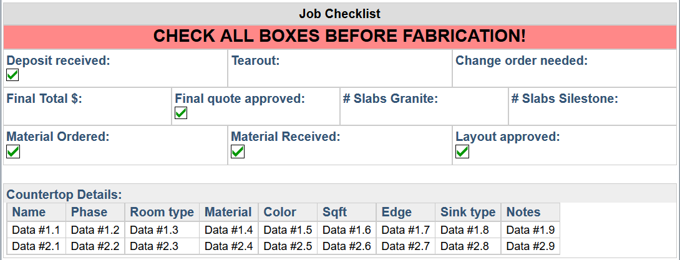
Formatting for communication
Notes:
Sometimes it’s worthwhile to format a cell specifically for viewing in JobDetails – rather than in print.
Here is example of pulling in form data from another form to summarize
Notice white space between sections

Slide 17
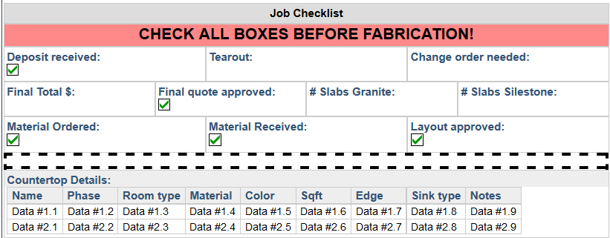
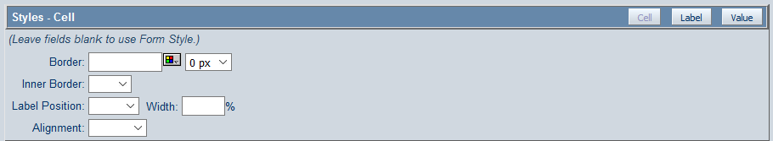
Formatting for communication
Notes:
Example of setting border to zero in order to create more white space on the printed page

Slide 18
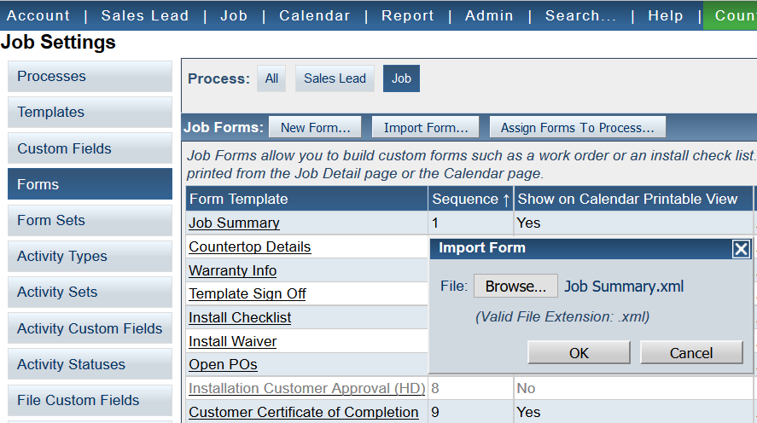
Import a JobForm
Notes:
We’ll send you a link to some example forms you are welcome to download and import
If you want to import one of our samples (or borrow one from somebody else using JT), here’s how…

Slide 19
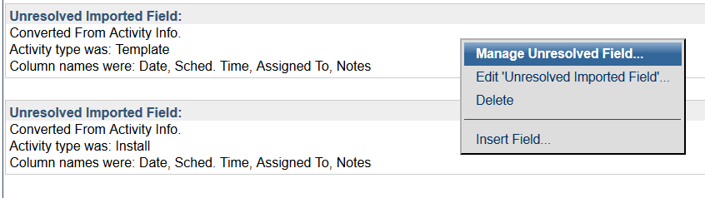
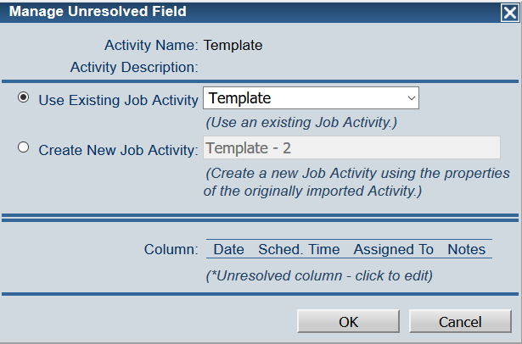
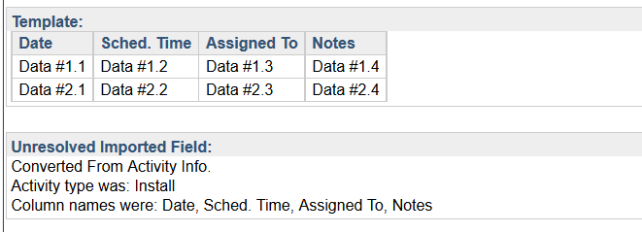
Manage Unresolved Fields
c
Notes:
After importing, you will often get an Unresolved Imported Field error. Main thing to know: you didn’t break anything.
Many times, all you need to do is click Manage Unresolved Field and then click OK.
If you still get some kind of error, it just means that the form is looking for information that does not exactly match the way you set up your system. Probably easiest to just ask for help if you can’t figure it out.

Slide 20

Organizing Jobs with Phases
Account
Job
Job
Activities
Phase 1
Phase 2
Activities
Activities
Files
Files
Using a simple details form also makes it easier to keep track of phases.
Notes:
Very powerful – but also requires caution. If you know you will be installing and fabricating separately, can help you keep jobs organized.
The caution? Story about making kitchen counter twice.

Slide 21
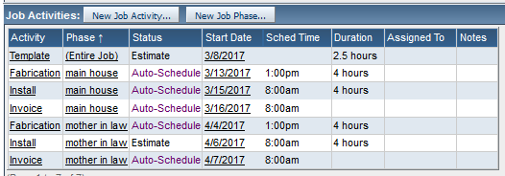
Assign Activities to Phases
Notes:
Here’s an example of a job with a list of Activities assigned to different phases. Notice that each Activity has a phase – even if Entire Job – rather than left “None”.
That’s a good practice.

Slide 22
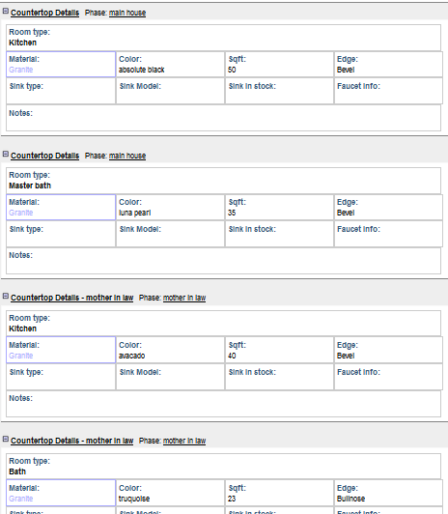
Assign Forms to Phase
Notes:
Similarly, every details form should be assigned to a Phase.

Slide 23
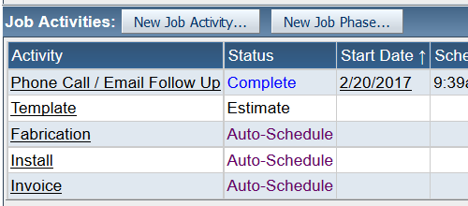
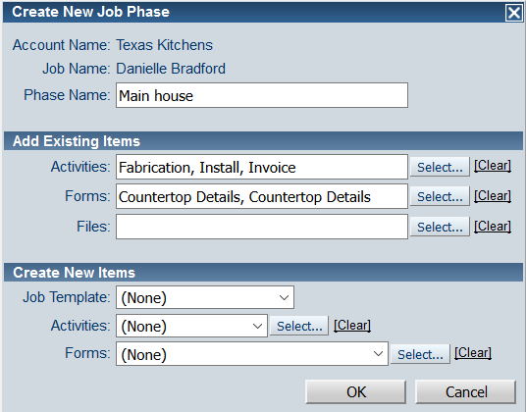
Add a Job Phase
c
Notes:
Click New Job Phase to add Phase. Rather than leave the existing Activities without a phase, create a phase for them first.
I only chose Fab, Install, and Invoice because I’m going to assign Template to Entire Job.
I also picked up the Existing forms that I knew where for the Main House phase

Slide 24
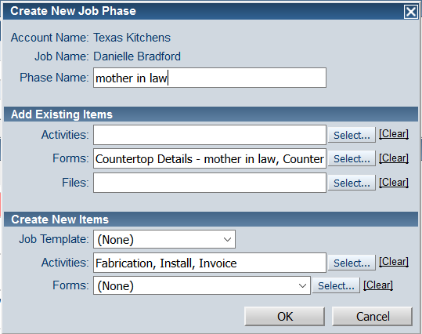
Add Existing Items and/or Create New
c
Notes:
Now I added a phase for the mother-in-law unit.
I’m adding existing forms for that phase and I’m creating new Activities.

Slide 25
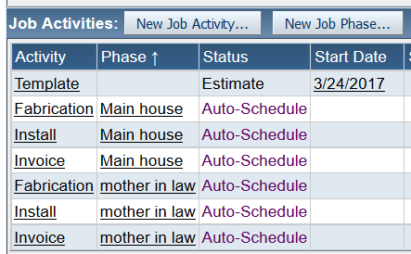
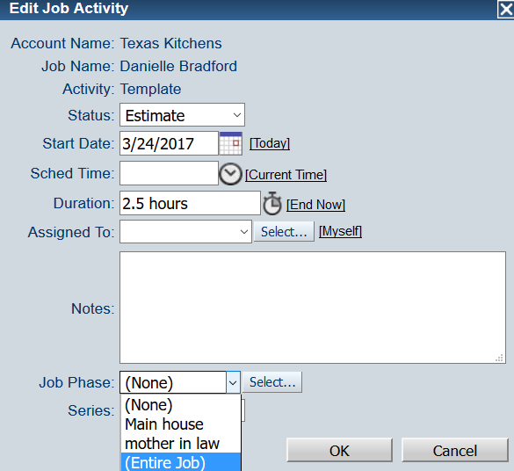
Assigning an Activity to Entire Job
c
Notes:
Now I’m assigning the “leftover” Template Activity to Entire Job.
If you aren’t templating the whole job at once, then you have more than one Template activity.

Slide 26
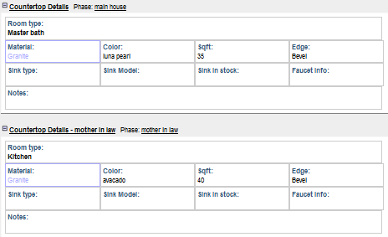
Every Activity & Form Assigned ONE Phase
c
c
c
Notes:
When every Activity & Form is assigned to a phase, the job is easier to understand – and you will avoid errors.

Slide 27
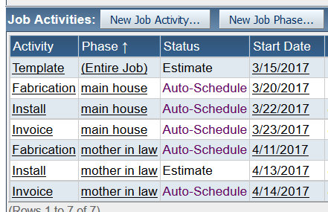
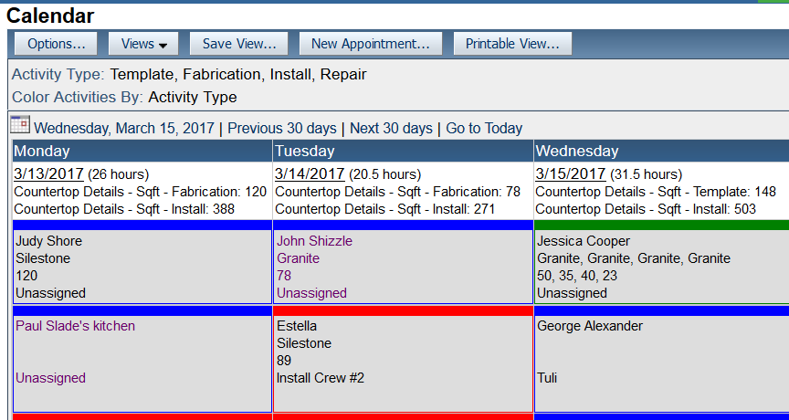
Template is Assigned to Entire Job
Notes:
Let’s look at the Calendar to get a sense of how this all relates.
Our Template was schedule for 3/15 and assigned to Entire Job – so all 4 Countertop Detail forms are assigned.
The Activity square and the subtotals reflect .

Slide 28
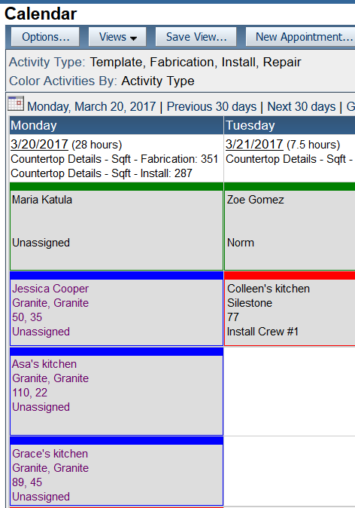
Fab for Main House on 3/20
Notes:
Main House Fab is scheduled for 3/20.
Activity square for Fab Activity on that day is pulling only 2 Countertop Detail forms: the 2 assigned to that phase.

Slide 29
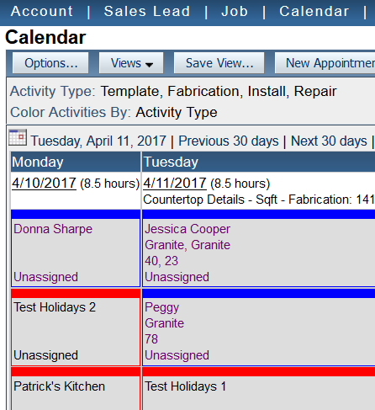
Fab for mother-in-law on 4/11
Notes:
Mother in law Fab is scheduled for 4/11.
Activity square for Fab Activity on that day is pulling only 2 Countertop Detail forms: the 2 assigned to that phase.
Foreshadowing – has implications for reporting.

Slide 30
